Slide 1




Team B.O.D.
Francesca Johnson
Matthew Hobden
Mike Davis
Mentors:
Dr. Tim Frank
Rick Sparber
The Engineering Institute at
SOUTH MOUNTAIN COMMUNITY COLLEGE

Slide 2
Introduction
HAM radio license
Why Needed
Acquisition Process
What we did
Successes
Lessons Learned
CANON Camera
Software Hack
Operation

Slide 3
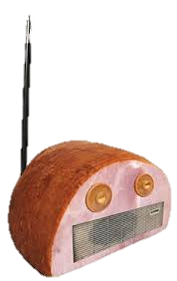


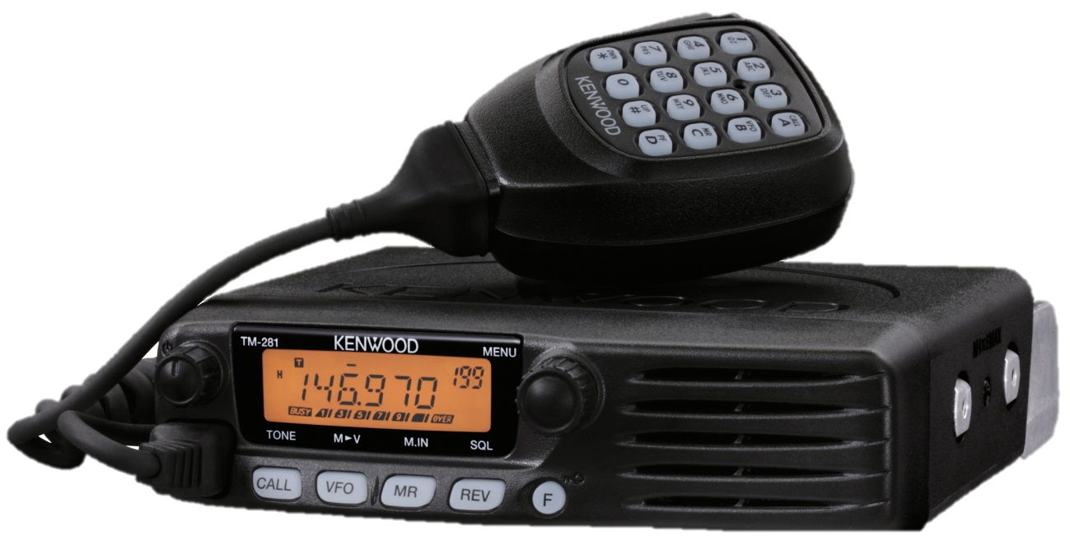
HAM RADIO

Slide 4
Physical Layer
System Block Diagram
Payload
GPS
Subsystem
(BRB)
GPS Antenna
Truck
HAM radio (receiver)
Terminal Node Controller
(TT4)
Truck Antenna
Digipeater
(ANSR Vehicle)
USB
Laptop

Slide 5
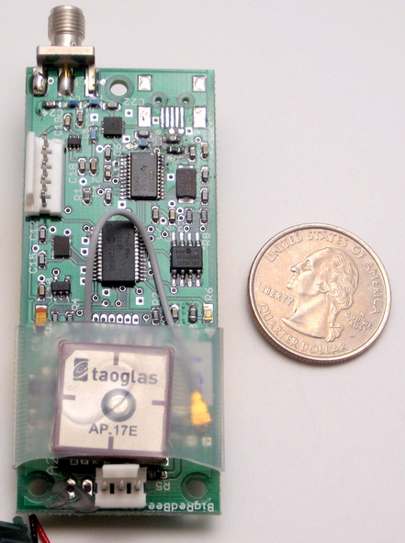
Tracking the Payload
Big Red Bee GPS Transmitter (BRB)
  5 Watt RF output
  Inside Payload

Slide 6
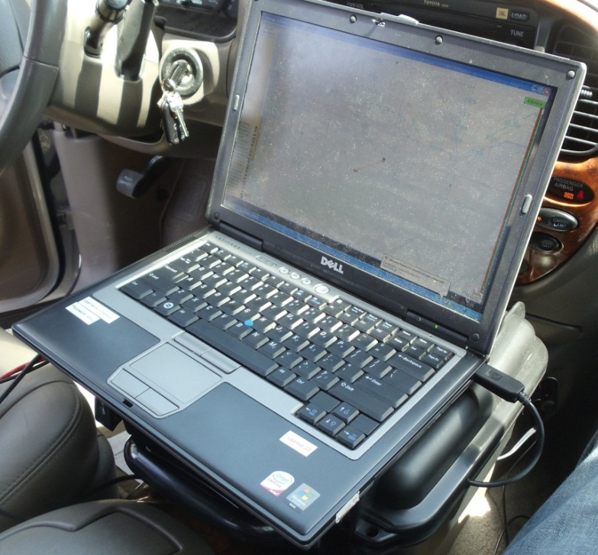
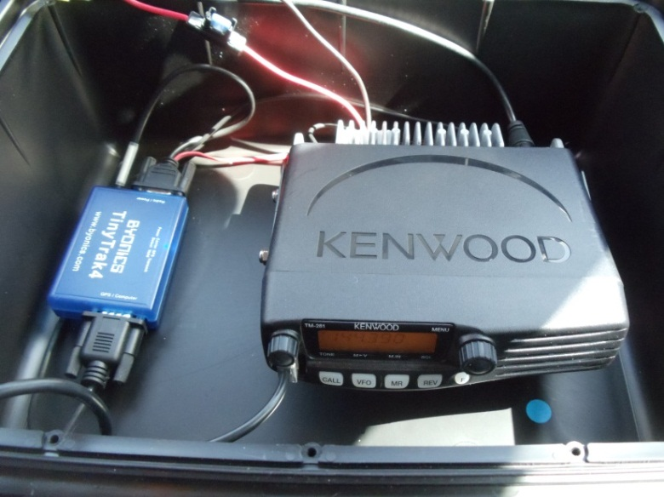
Chase Vehicle Equipment
Laptop with APRIS32 Software
TinyTrak 4 (TT4) and HAM Radio

Slide 7
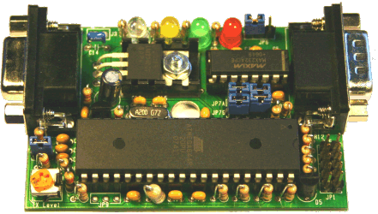
Decoding the Packets
Tiny Track 4 (TT4)
  Decodes packets received by Kenwood TM-281A Radio
  Sends the decoded packet to Laptop
  Inside chase vehicle
  Least favorite component
  ☹

Slide 8
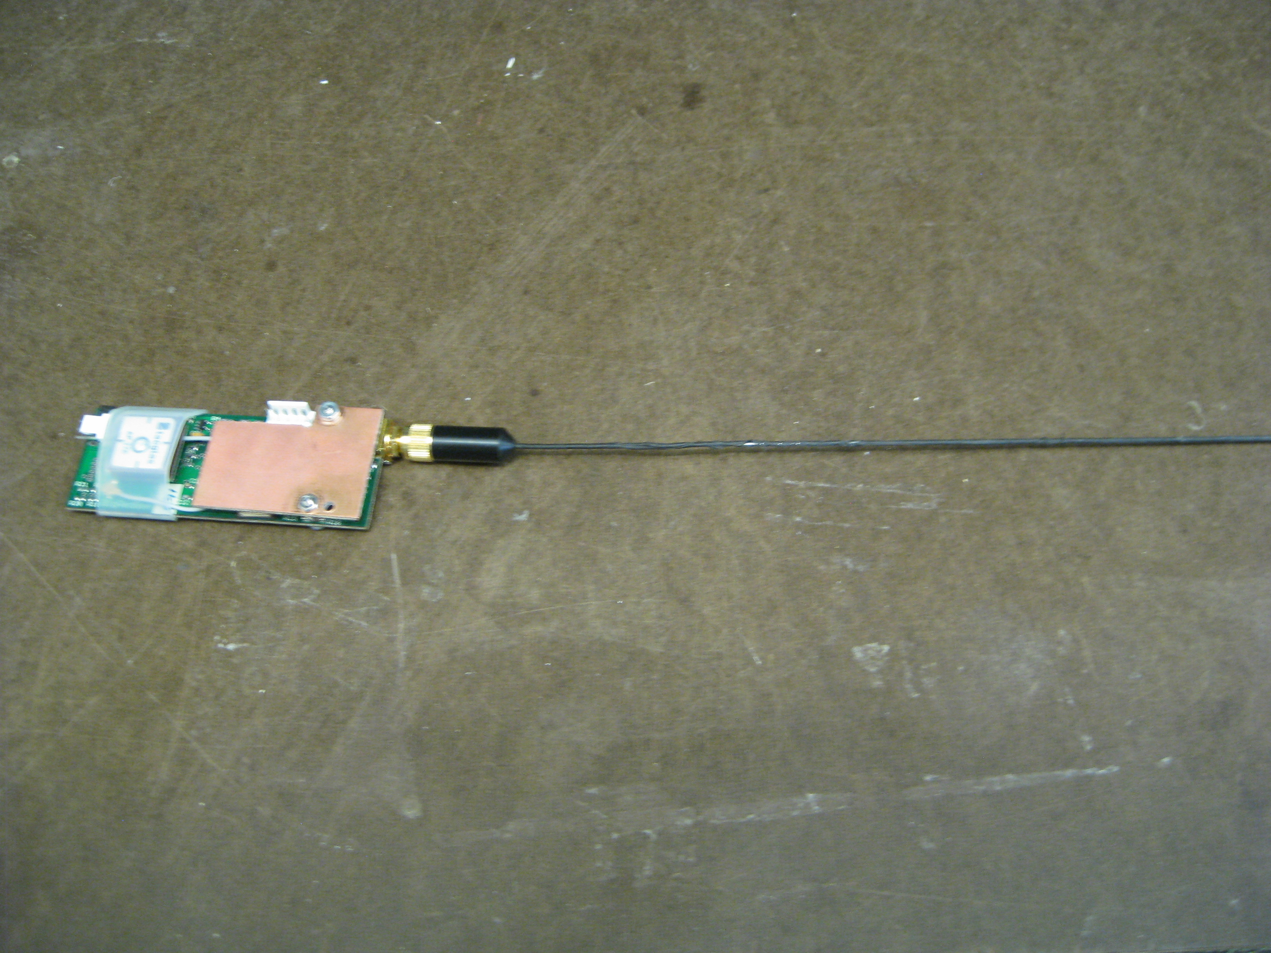
Functioning Antenna

Slide 9
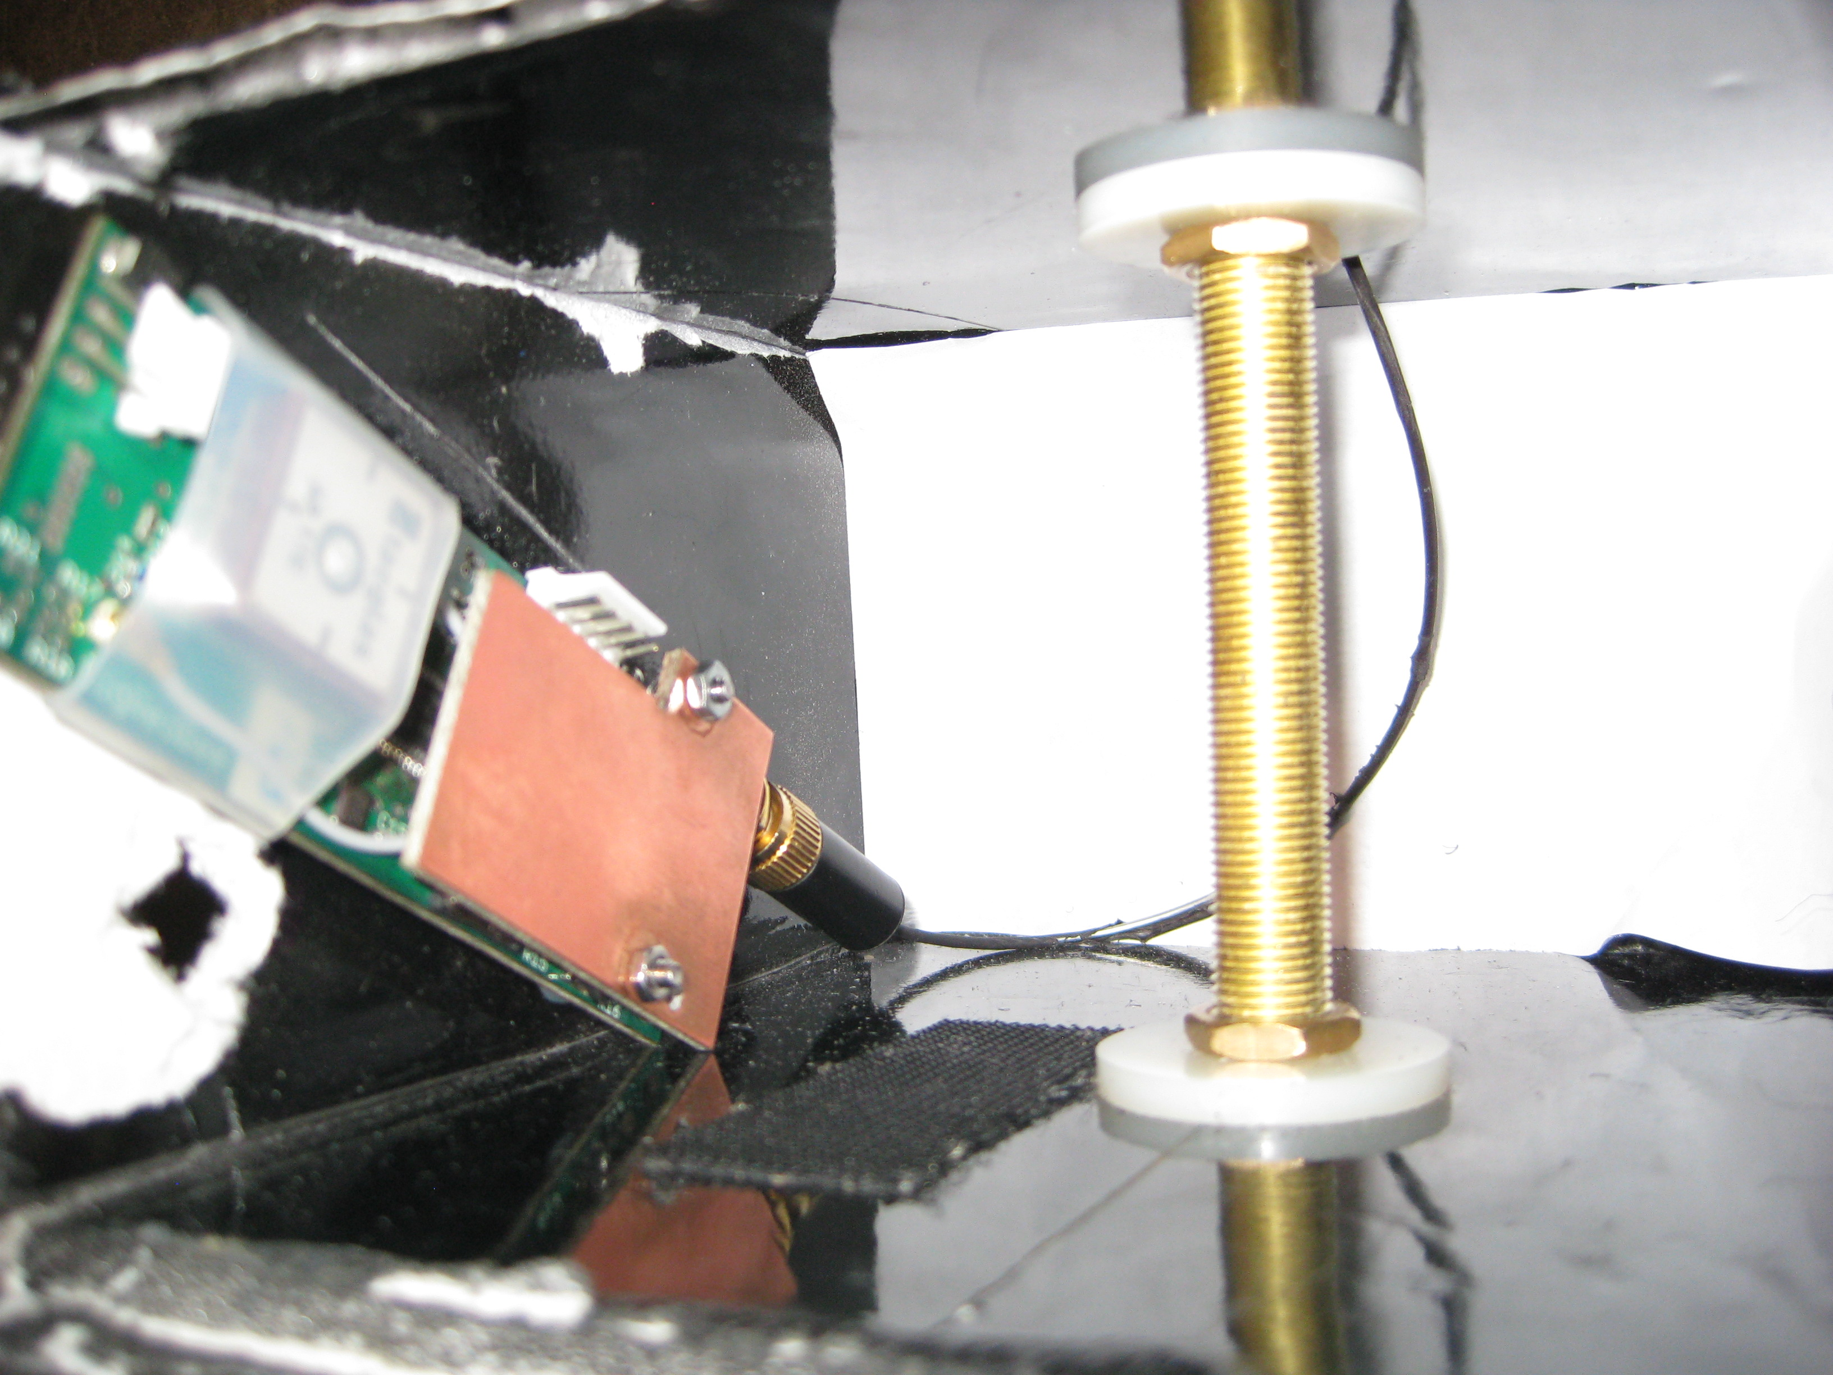
Non-Functioning Antenna

Slide 10
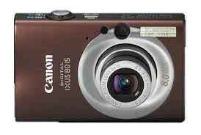
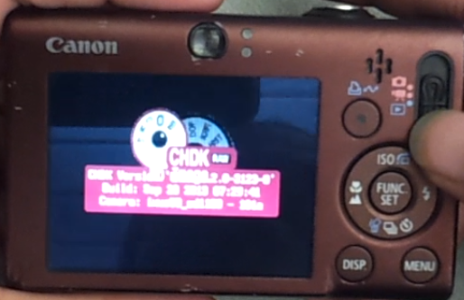
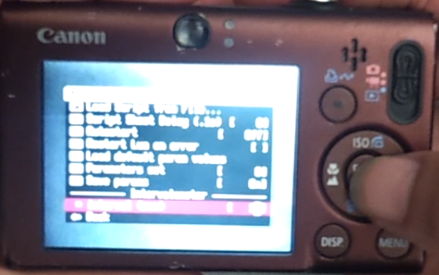
CANON - CHDK Hack

Slide 11
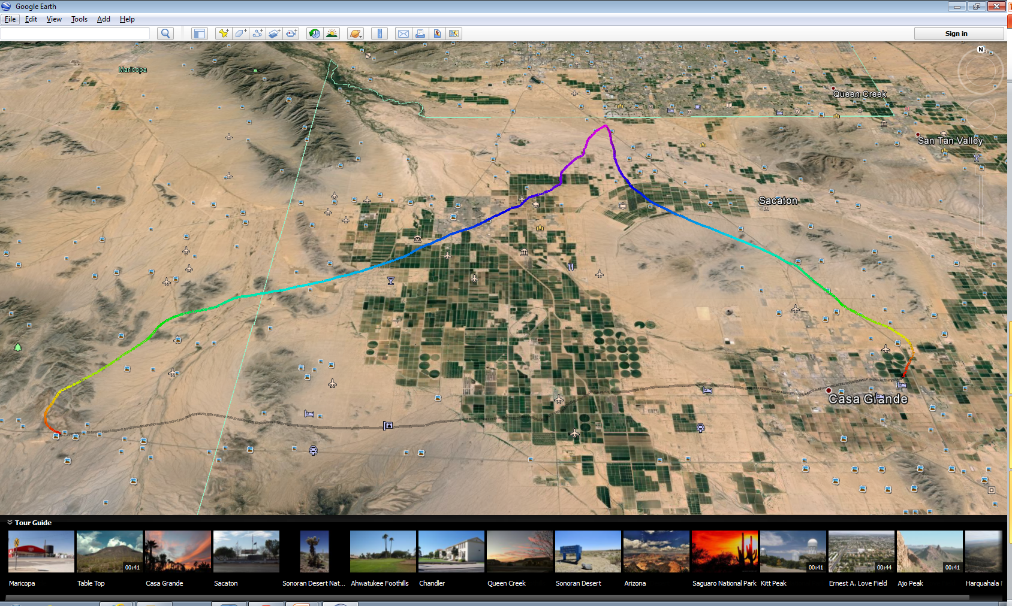
Flight Path

Slide 12
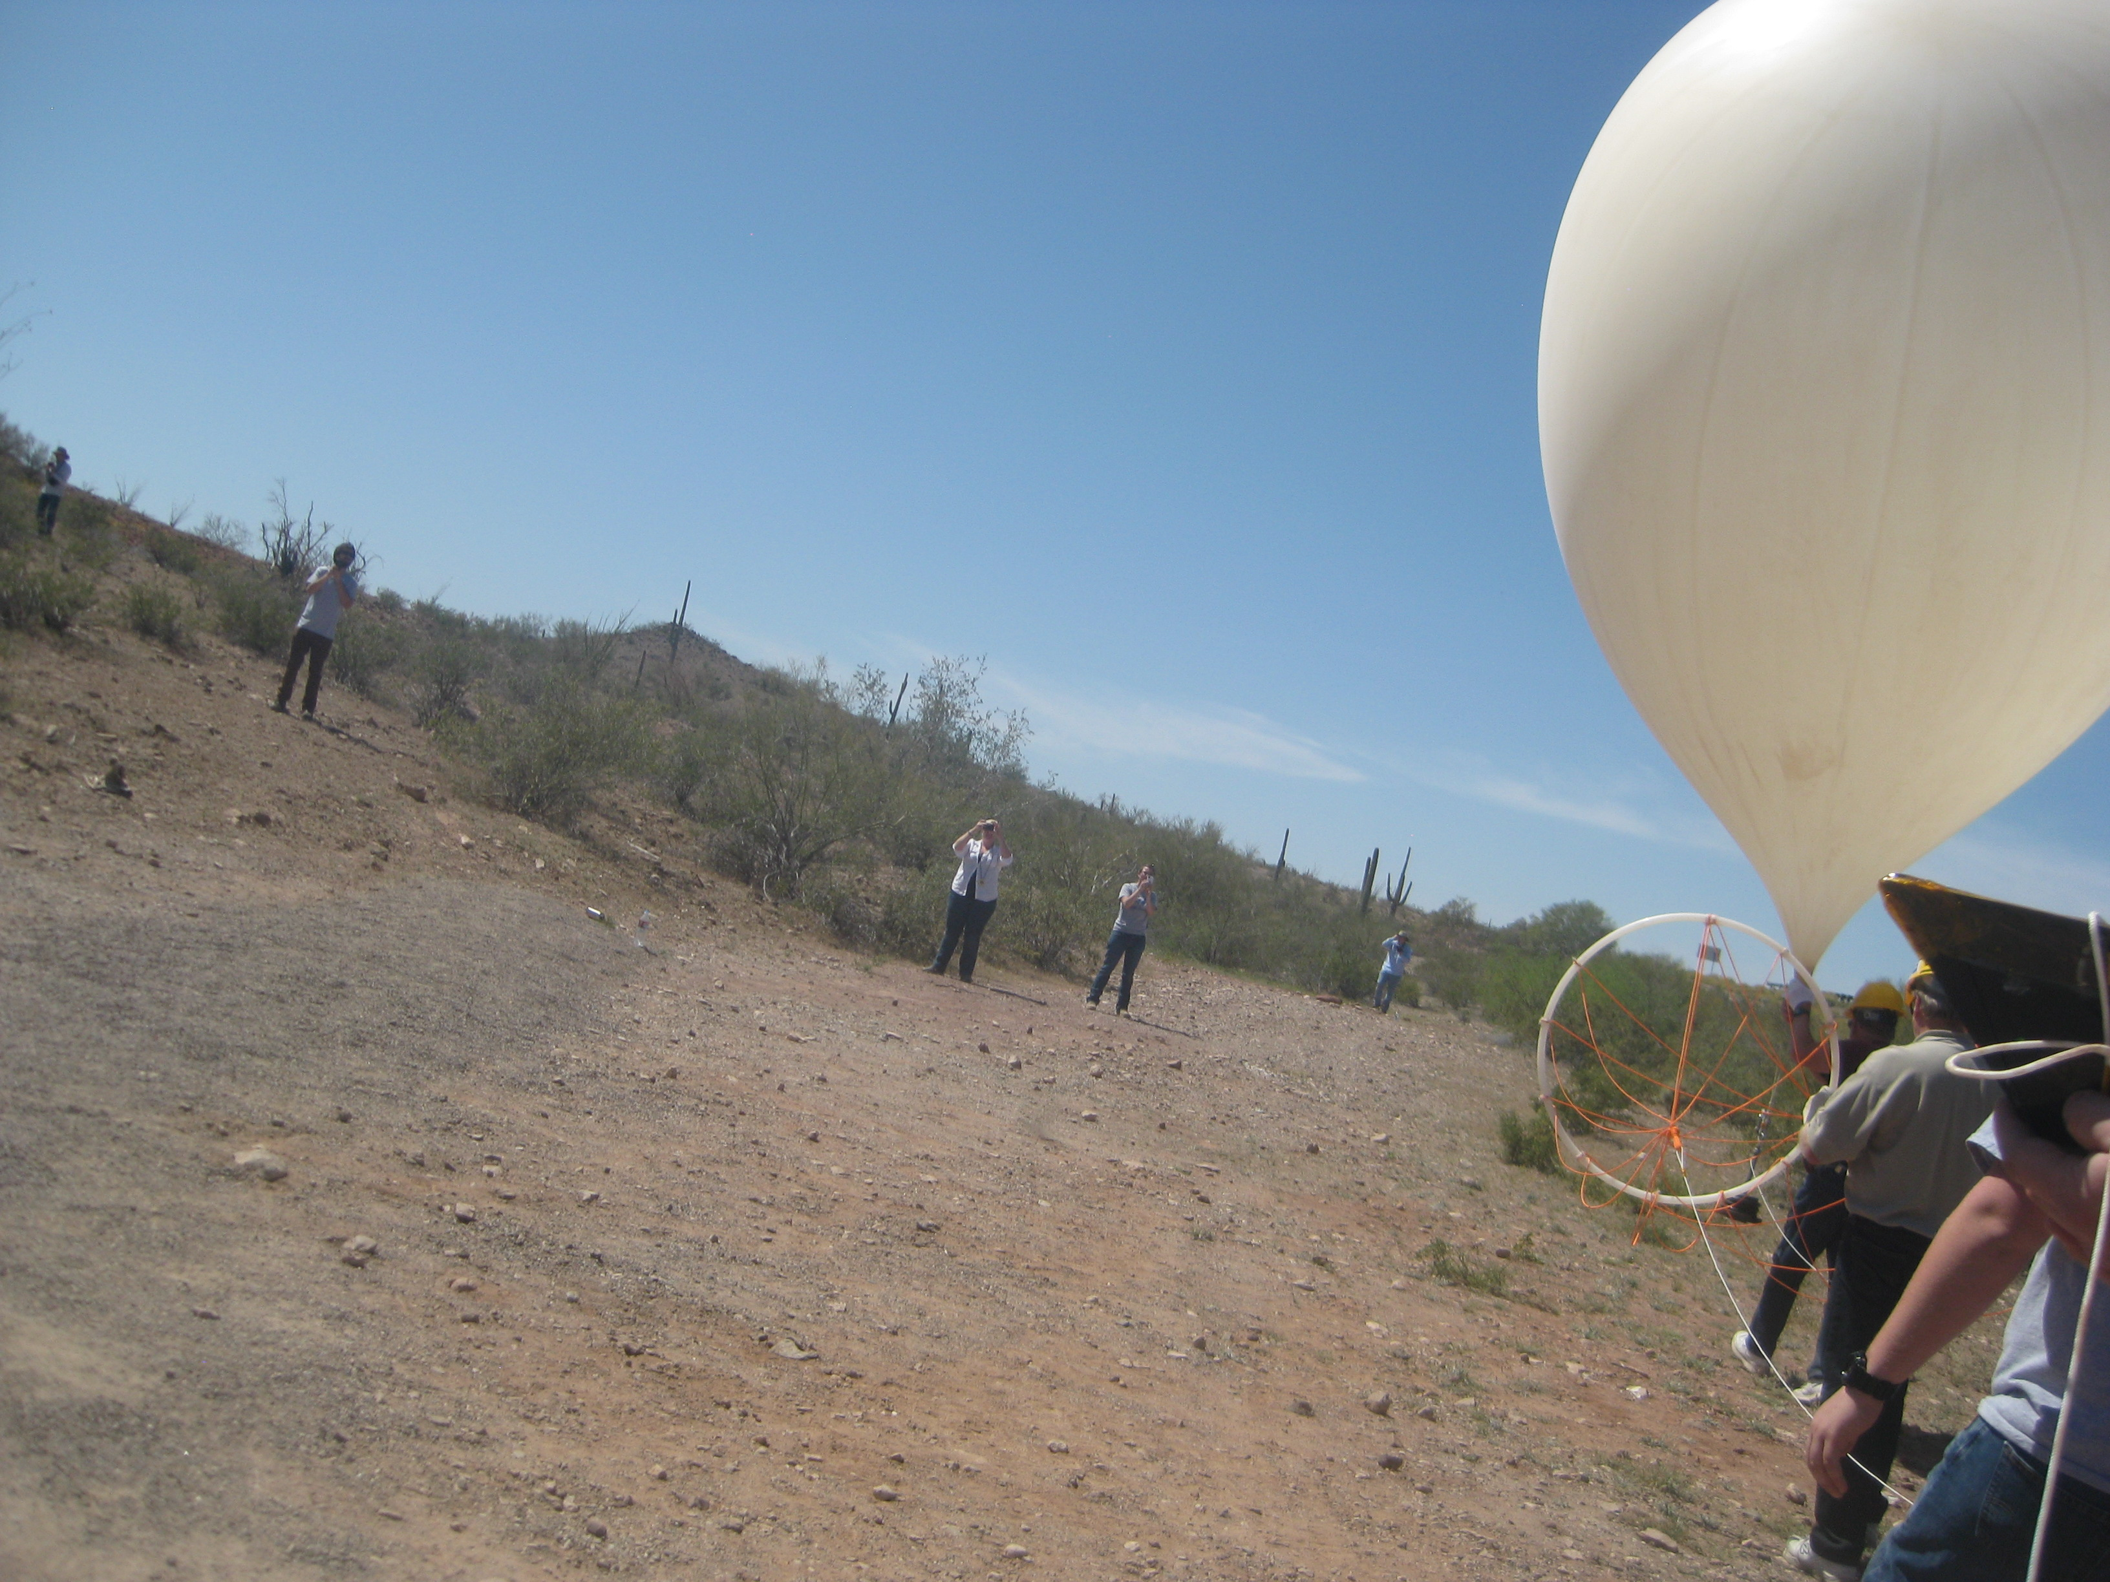

Slide 13


Slide 14


Slide 15


Slide 16
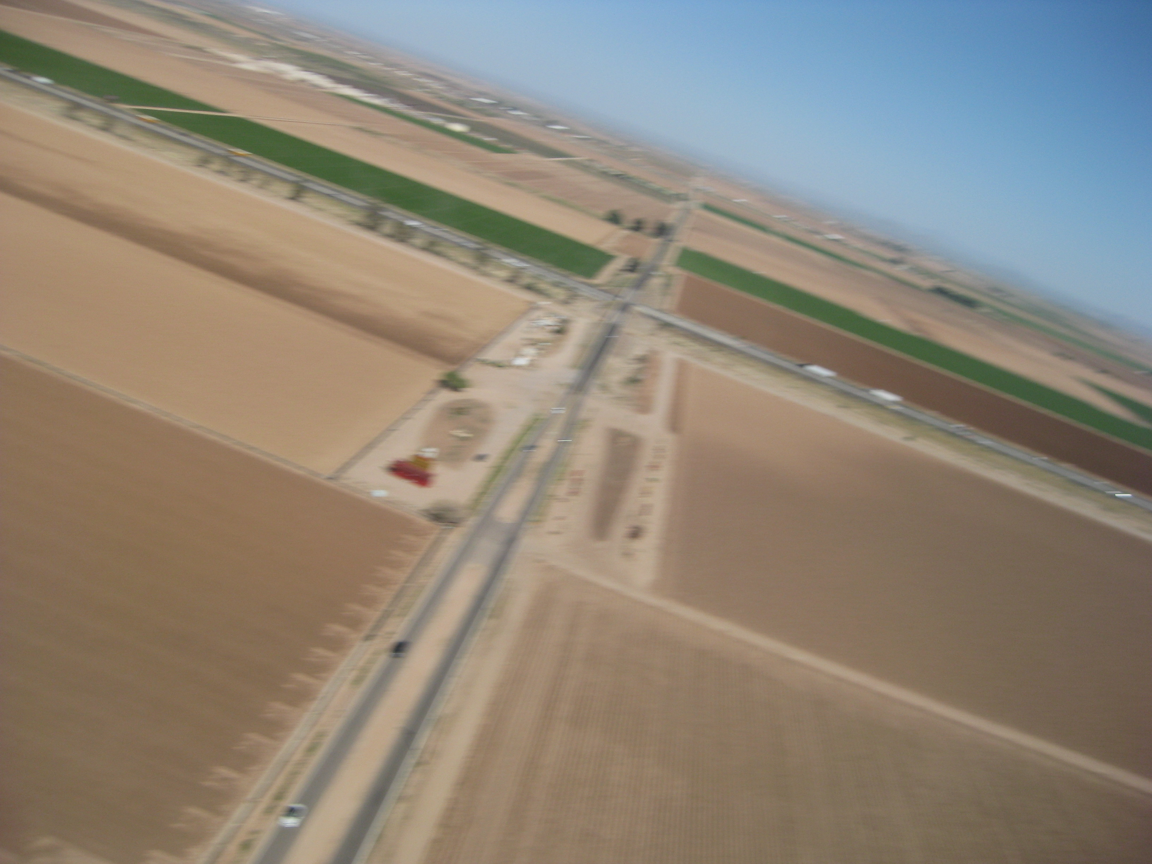

Slide 17



